Slide 1
LIBRESELL
Presented By:
Mahima Jindal
MCA Semester 2 (Section 1)

Slide 2
INTRODUCTION
A form of electronic commerce
All consumers directly buy used books from a seller in real-time
connects local people to buy, sell or exchange used books by making it fast and easy for anyone
Sellers can easily earn some extra cash by simply posting books that they are no longer using them - thus, giving buyers the opportunity to find great value books at affordable price deals.
To give customer to customer (C2C) platform

Slide 3
OBJECTIVE
Consumers directly buy second hand books from a seller at affordable prices by seeing the location of the seller who is providing the book.
Its shows the consumer interest books according to the distance between consumer and seller.
Most nearest seller is shown at first when someone search a book , then in increasing order of distance.

Slide 4
Software Requirements
Front-End: HTML, Bootstrap, CSS, JavaScript
Back-End: MYSQL
Server: WAMP
Web Browser: Google Chrome

Slide 5


ADVANTAGES
Convenience
Information
Price and selection
To save time and money
To increase the availability of books
DISADVANTAGES
Fraud and security concerns
Lack of full cost disclosure

Slide 6
SYSTEM DESIGN
ER DIAGRAM
USE CASE DIAGRAM
DFD

Slide 7
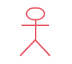

USE CASE
Update Cart
LOGIN
Register
View Books
Manage Details
BUYER
Manage User Details
Add to Cart
Feedback
Manage Category
Payment
View Orders
Manage Details
Manage
Feedback
SELLER
Manage Books
LOGOUT

Slide 8
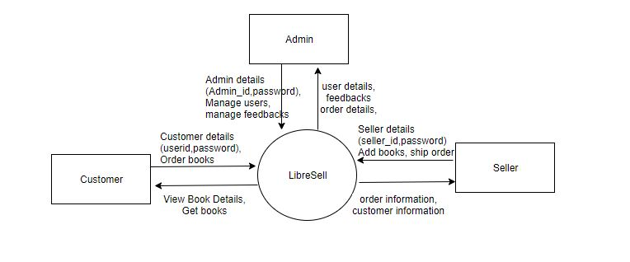
DFD
Context level

Slide 9
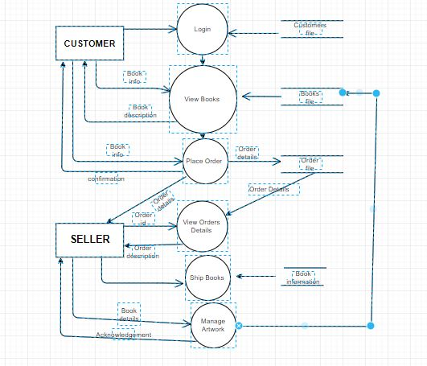
FIRST LEVEL
1
2
3
4
5
6

Slide 10
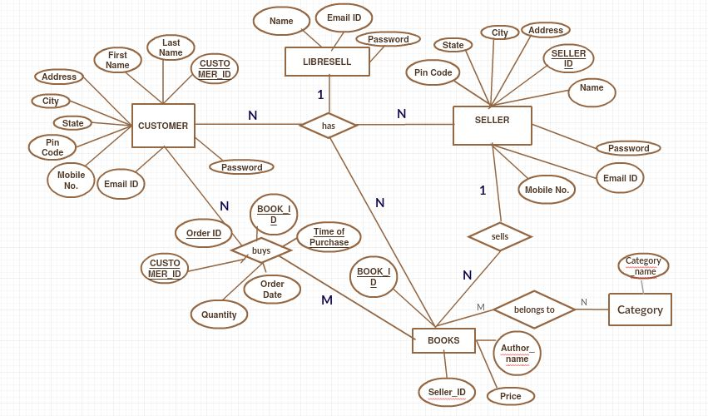
ER-DIAGRAM

Slide 11
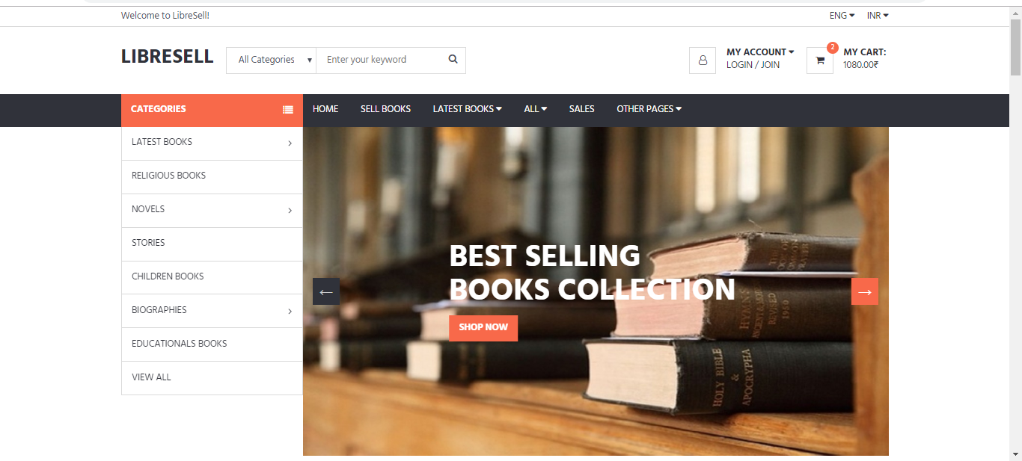
Screenshots

Slide 12
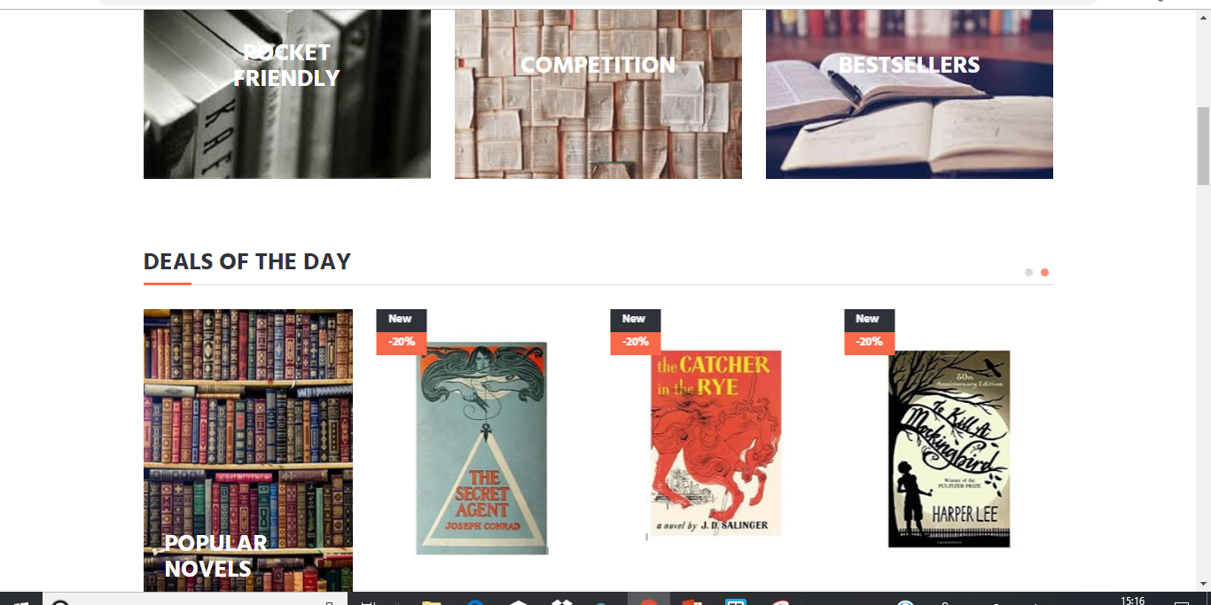

Slide 13
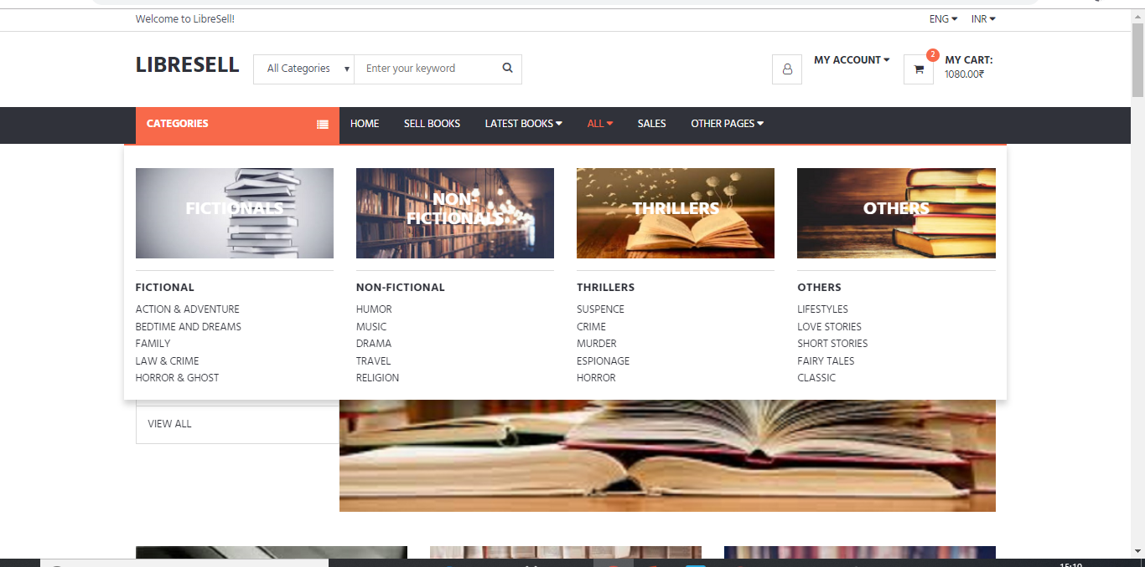

Slide 14
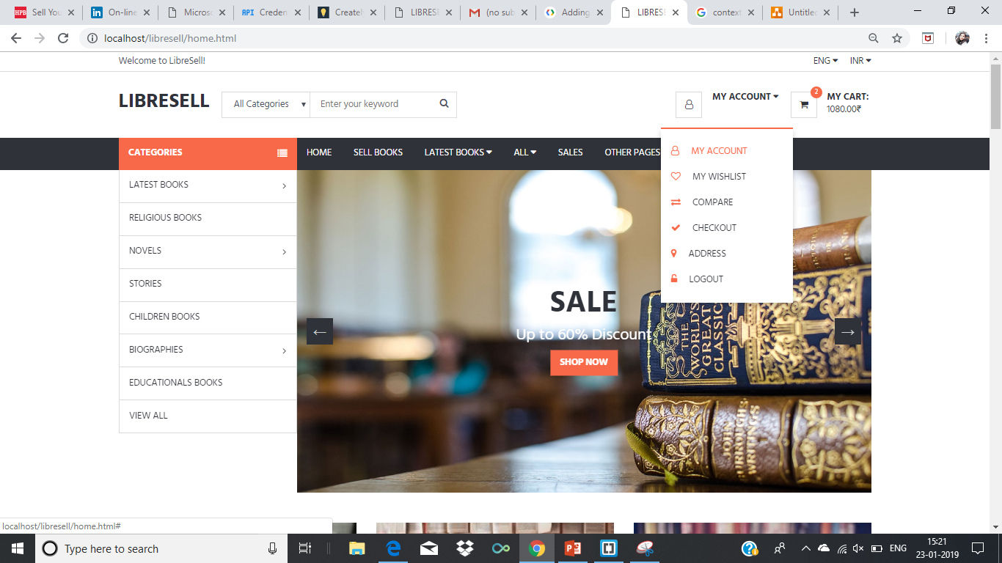

Slide 15
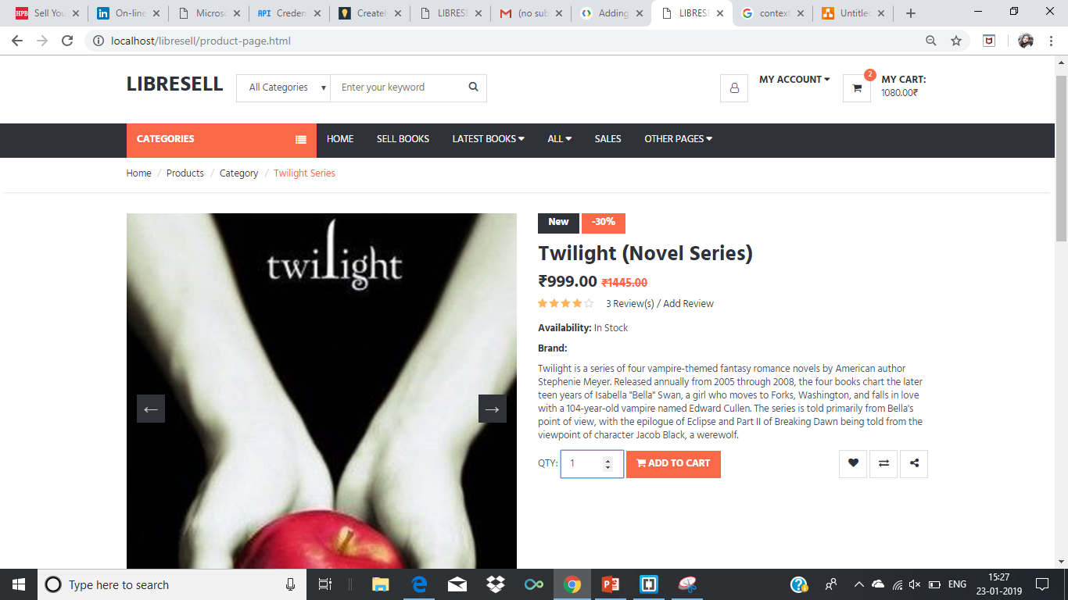

Slide 16
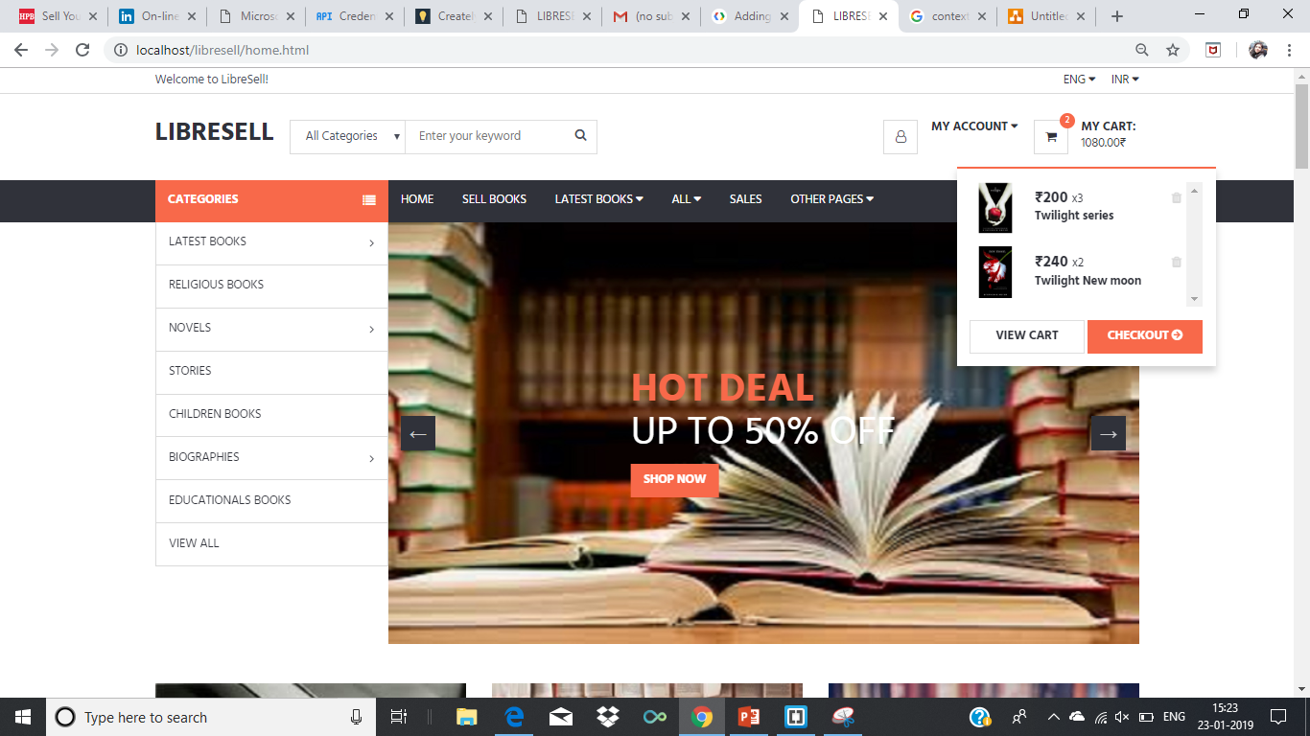

Slide 17
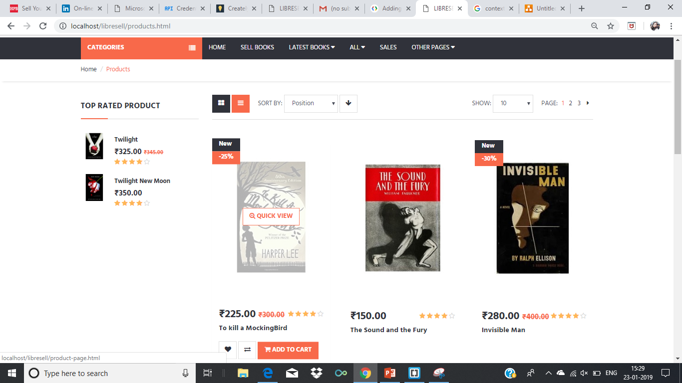

Slide 18
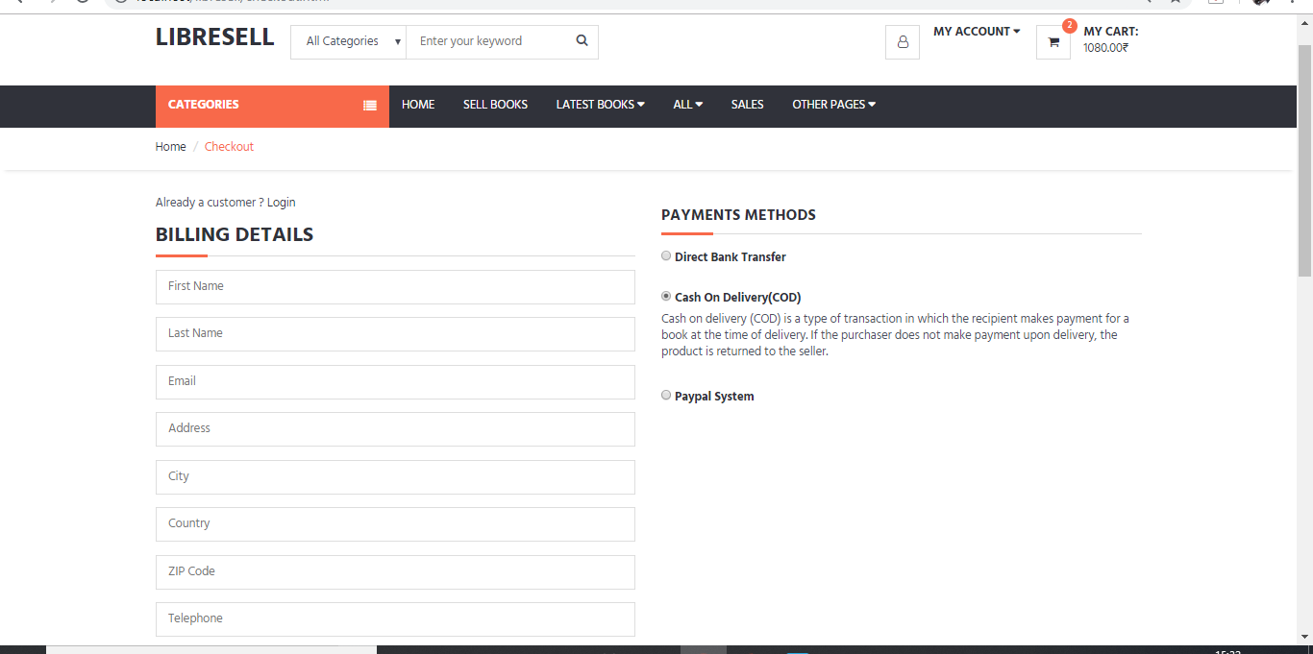

Slide 19
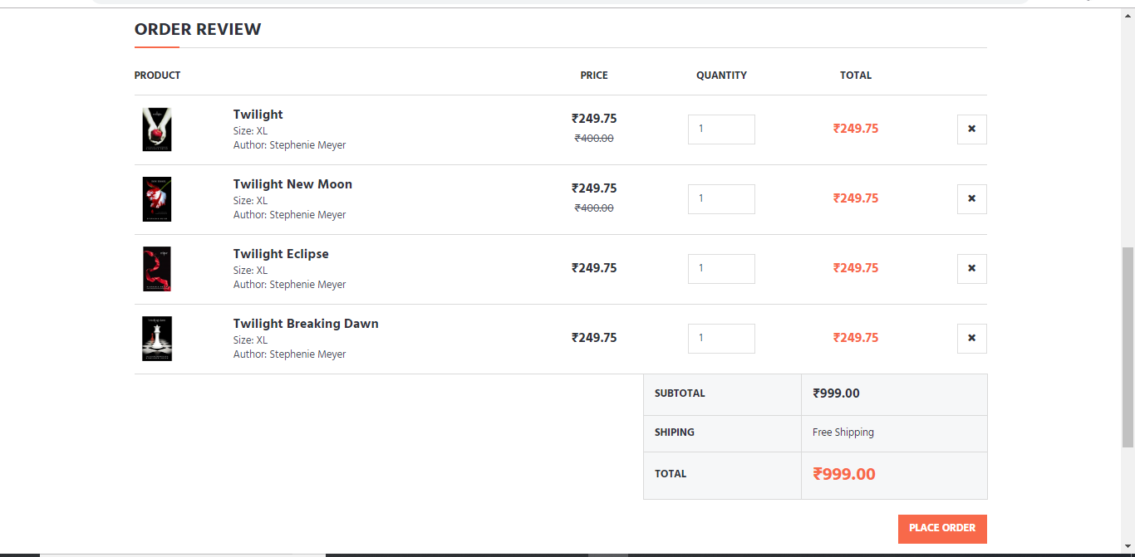

Slide 20
FUTURE SCOPE
Improve user experience.
To develop a mobile android application for it.

Slide 21
THANK YOU

